Slide 1

Rockbuster
Stealth
Data Analysis
By Azumi Muhammed

Slide 2

Project Overview
Rockbuster Stealth LLC is a movie rental company that used to have stores around the world. Facing stiff competition from streaming services such as Netflix and Amazon Prime, the Rockbuster Stealth management team is planning to use its existing movie licenses to launch an online video rental service to stay competitive.

Slide 3

Project Objectives / Questions
Revenue Analysis
Which movies contributed the most/least to revenue gain?
Rental Duration
What was the average rental duration for all videos?
Location Analysis
Which countries are Rockbuster customers based in?
Customer Analysis
Where are customers with a high lifetime value based?
Spatial Analysis
Do sales figures vary between geographic regions?

Slide 4
Rockbuster Company Overview
599 Customers
1000 Rental Films
5 Days Average Rental Duration
Average Rental Cost of $2.98
Average Replacement cost of $19.98

Slide 5
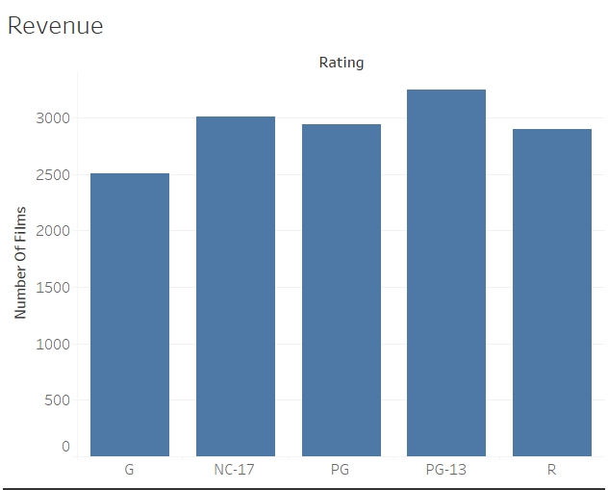
Rating Analysis
Most Revenue Generated
PG- 13 rated Films
List revenue Generated
G rated films

Slide 6
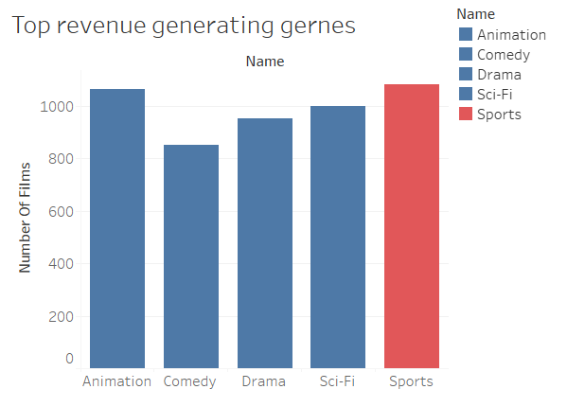
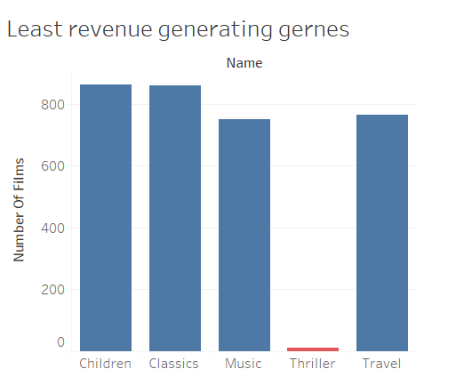
Genres Analysis
Sports accounts for the highest revenue generation genre
Thriller films accounts for the lowest revenue generating genre

Slide 7
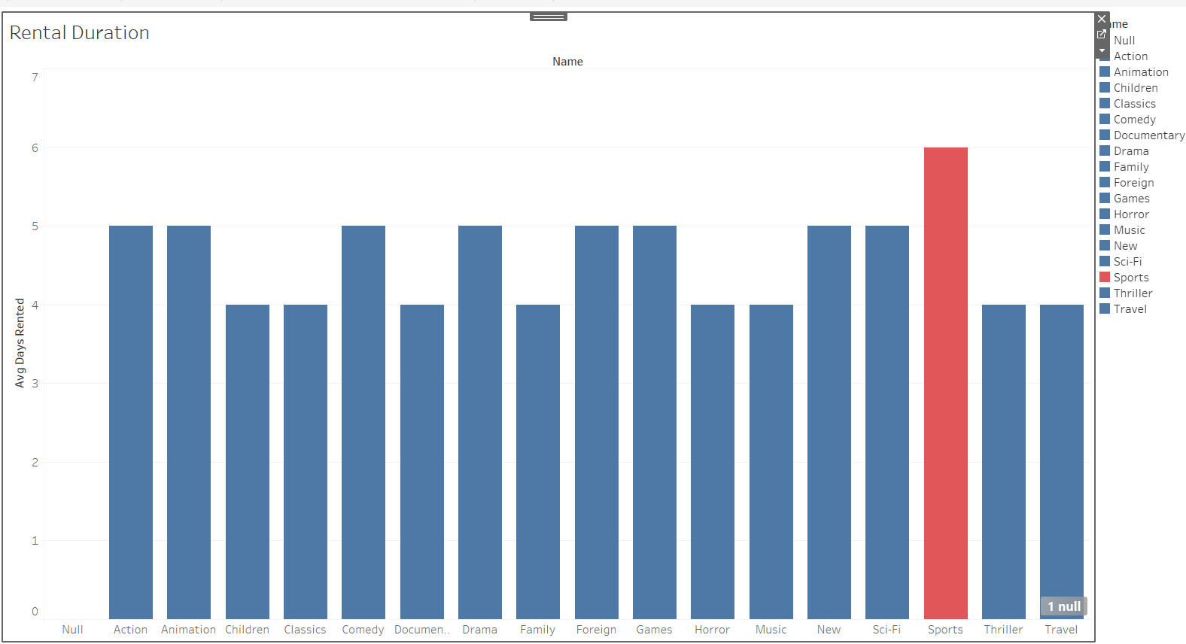
Rental duration
Sports genres are rented for an average of 6 days compared to the other genres

Slide 8
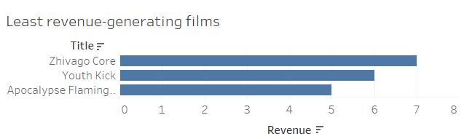
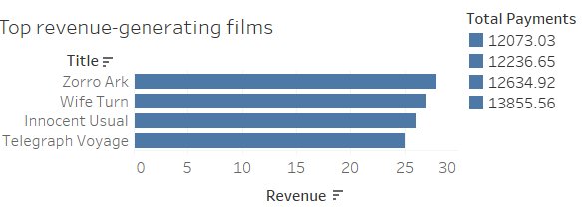
Film Analysis
Top revenue
Least revenue

Slide 9
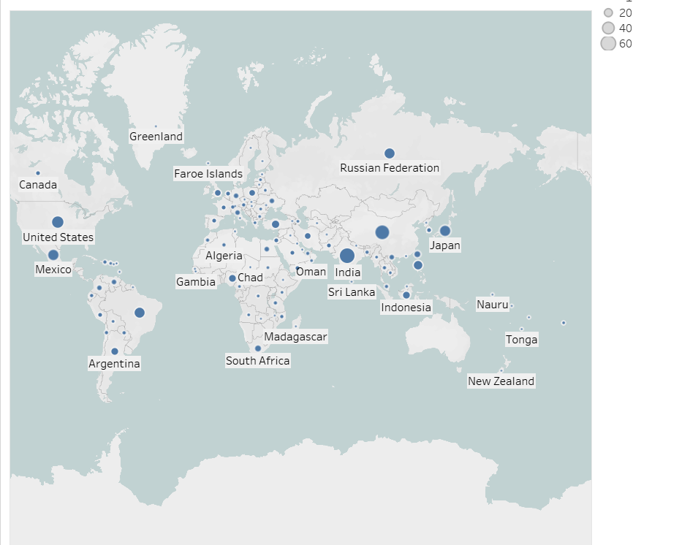
Countries with Rockbuster´s Customers
Rockbuster’s customers are Located in 108 Countries Worldwide.

Slide 10
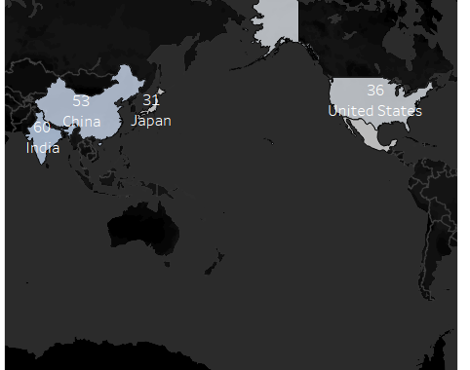
Top Revenue Generating Countries
India total of 60 customers
China total of 53 customers
United States total of 36 customers
Japan total of 31 customers.

Slide 11
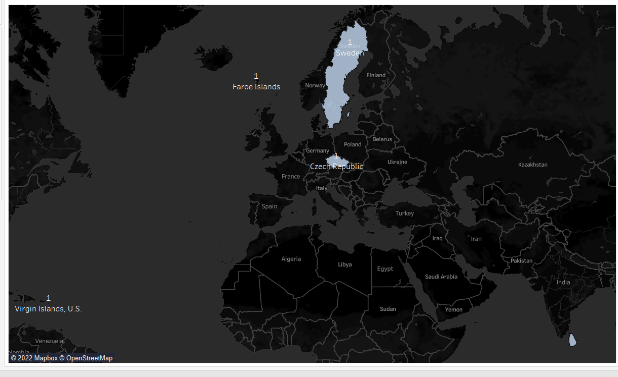
Least Revenue Generating countries
Faroe Islands
Sweden
Czech Republic
Sri Lanka
Virgin Islands, U.S.
All these Countries stated have a total of one Customer each.

Slide 12
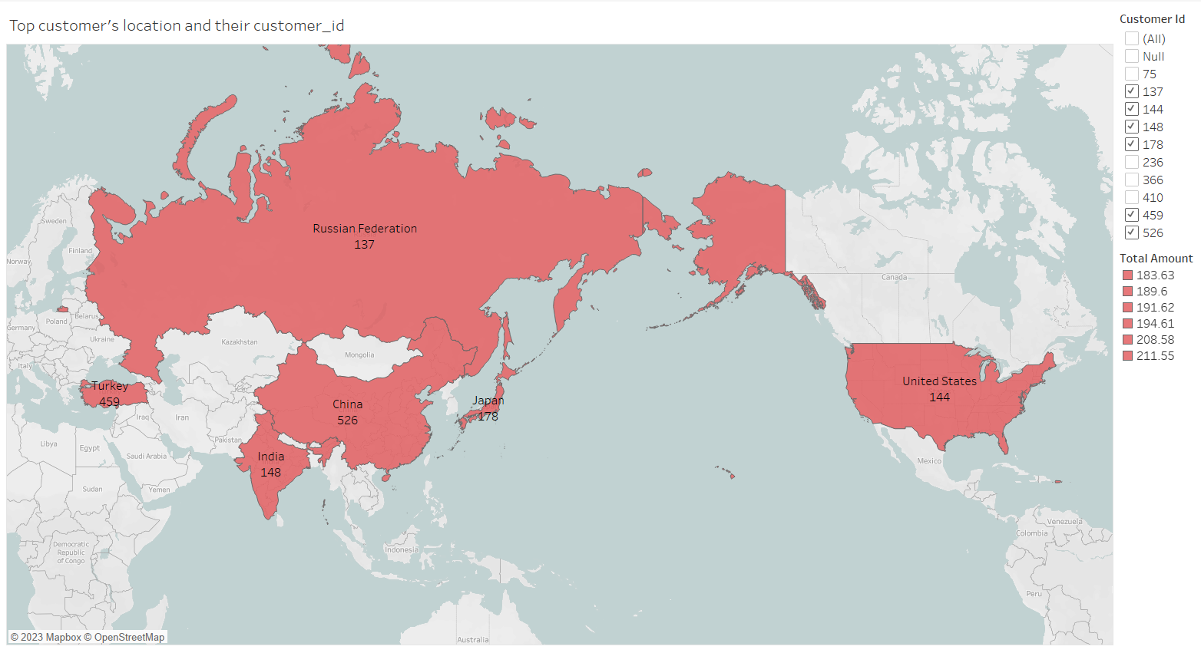
Top customers

Slide 13
Recommendations
The management team should use its existing movie licenses to launch top revenue-generating films and genres on an online video rental and also focus on creating more varieties for customers to stay competitive.
Promotions can be provided to customers in Countries with low revenue to improve sales.
Implementing strategic marketing such as advertisements and sales promotions to catch public attention, and providing easy and convenient payment methods to customers worldwide will help to stay competitive.
Customer relationships should be maintained by providing loyalty cards to all customers and reasonable discounts should be given to top customers.

Slide 14

cymuhammed@yahoo.com
Rockbuster Stealth | Tableau Public

